Slide 1

Documentation in Postman
Deepika KARANAM

Slide 2
Need for documentation
Collaboration
Building awareness of your API
Gaining adoption of your API
Guide onboarding
Explain Authentication
Interactive demos
QuickStart and real-life example
Sample Code
Organize and reference

Slide 3
Generating Documentation
Documenting an existing collection
Creating documentation for new collection
Including detail in docs

Slide 4
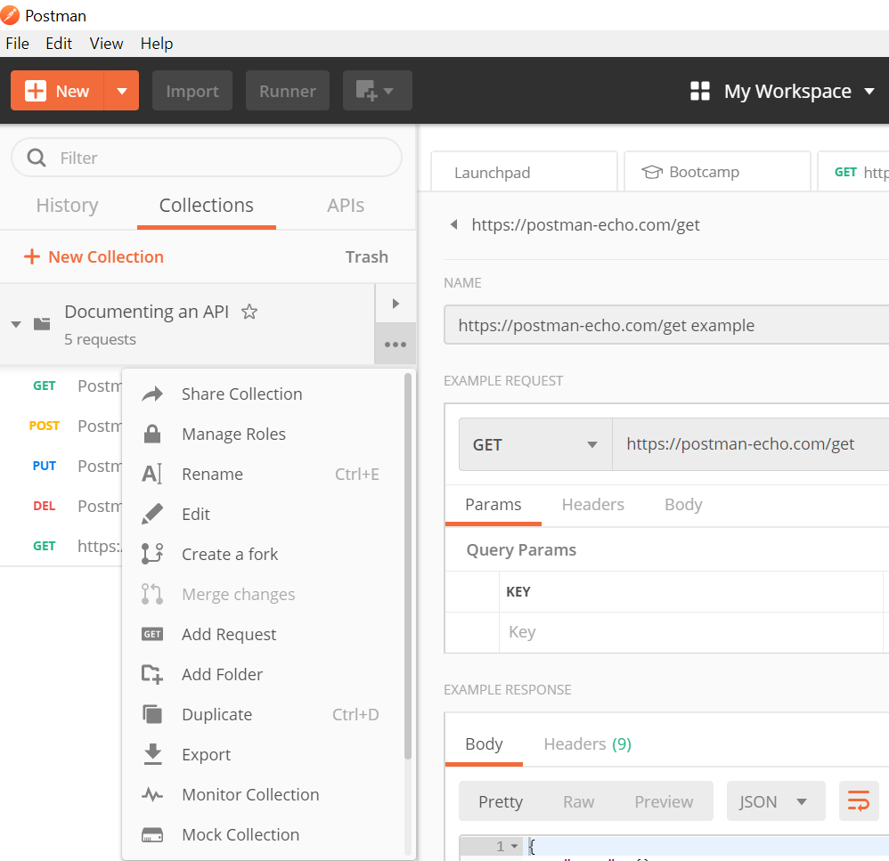
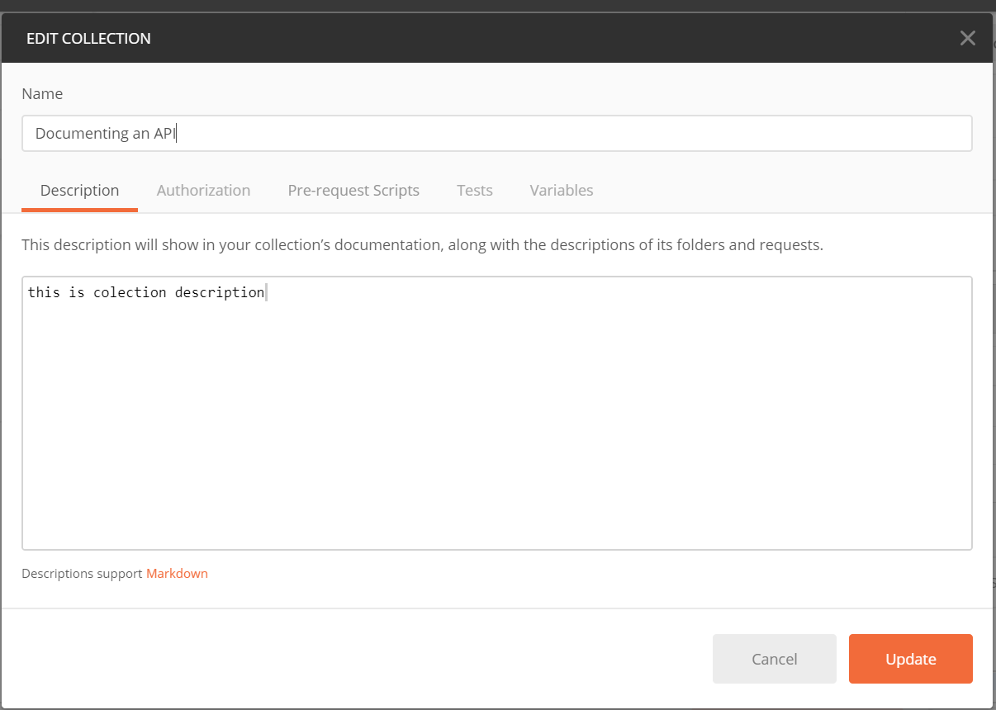
Documenting an existing collection

Slide 5
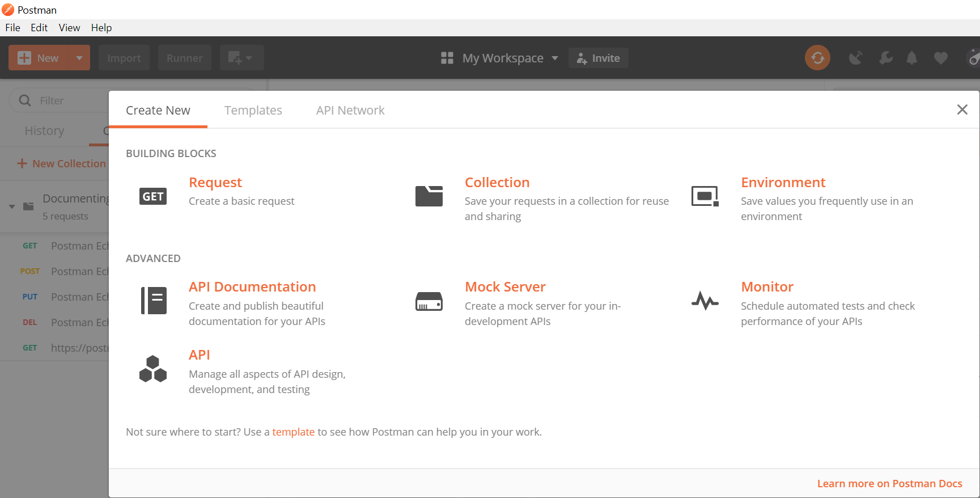
Creating documentation for new collection

Slide 6
Details included by default in documentation
Introduction What does your API do?
Overview Things that the developers should know about
Authentication What is the preferred way of using the API?
Error Codes What errors and status codes can a user expect?
Rate limit Is there a limit to the number of requests a user can send?
** We can add additional detail in this page or directly on the web

Slide 7
Including details in Docs
Docs will automatically include detail on your requests, with sample code in various client languages.
Each collection / request listing indicates -- the method, URL, description, headers, request and response structures, and examples.
Private docs –a link to share the associated collection
Public docs include a Run in Postman button
Documentation page is structured to reflect the folders and requests in the collection.

Slide 8
Documentation environments
To set variables that will be available in documentation
Private – able to access environments shared with them
Public – select an environment to share during publication
Variable values will be published explicitly docs, so make sure they don't contain any sensitive data.

Slide 9
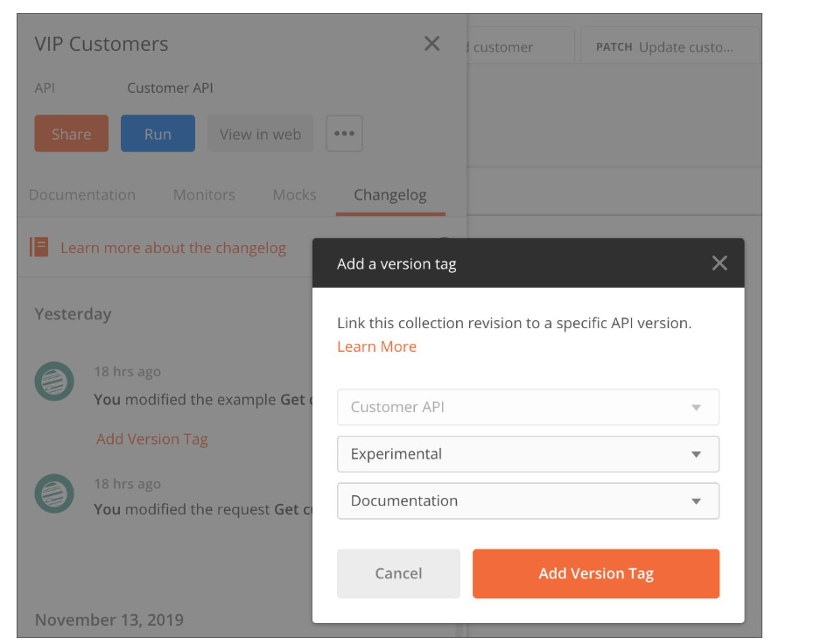
Versioning Docs

Slide 10
Authoring Documentation
Documenting with descriptions
Describing collections
Documenting request detail
Parameters and headers
Using examples in your docs
Documentation links
Using images in docs
Markdown demo collection

Slide 11
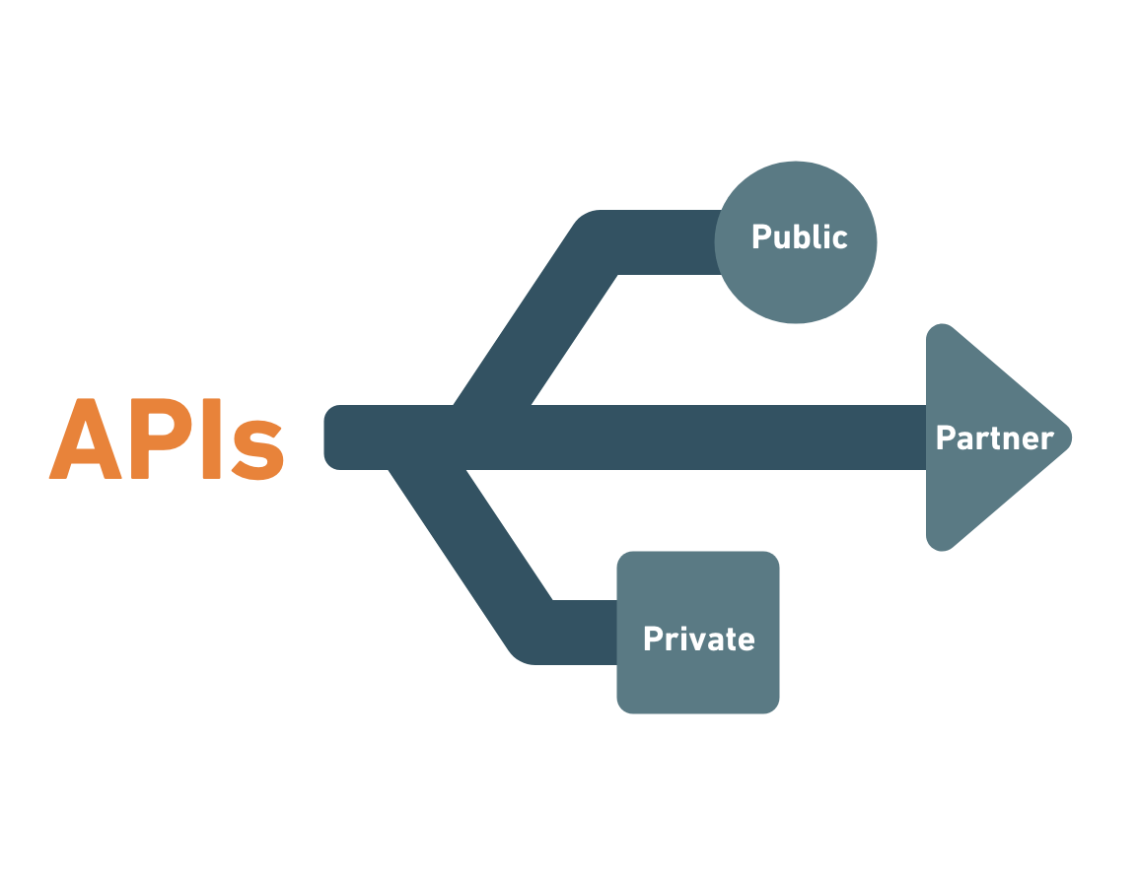
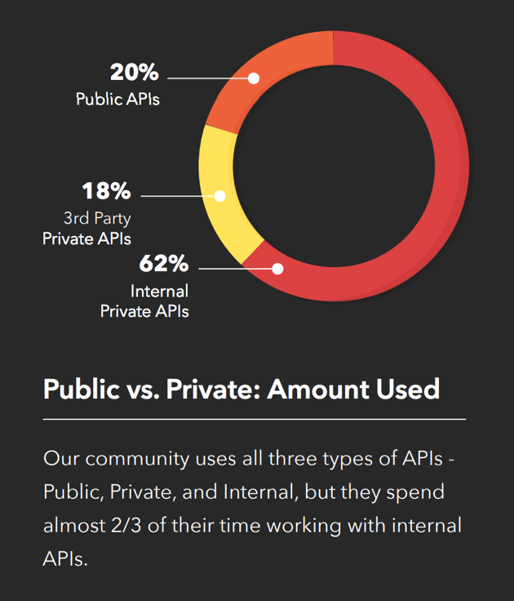
Publishing Docs
API is used by others, it is considered published , whether documented or not.

Slide 12
Making Documentation Public
Publish docs from an existing private documentation page or from the collection in the Postman app.
Remove all sensitive information from the environment before you publish.
Configuring your public docs
Can configure how public docs look- select version and environment and can preview
Customizing docs
Configure the style of your public docs
Add a team name and logo via team settings

Slide 13
Sharing Public Docs
Collection discovery
Add to API network – feature docs in Postman Publisher network(only when publishing from a team).
Add to Postman Templates – Sharing collection with Postman community and discoverable through app.
Publishing and unpublishing.
Commenting on documentation.
Custom Documentation Domains

Slide 14
Questions , Suggestions and Feedback

Slide 15
Thank you

